Slide 1
Trade route logistics
A game simulation

Slide 2
Cottonbog
Village engaged in the production of cotton.
Traders travels to nearby villages to sell cotton and buy food and commodities
Cottonbog trading route contains three major villages.

Slide 3
Slagtown
Travel time is three weeks
Relatively safe: the road is guarded by city soldiers
Toll of 250 (Need to pay both ways)
The price of cotton is lower than other cities
Goldford
Travel time is one 5 weeks
There are no guards on this road, and the risk of raids from bandits are high
The price of cotton is higher than other cities
Coalpeak
Travel time is 9 weeks
There are no guards on this road, but is still relatively safe
The price of cotton is lower than other cities

Slide 4
Research question/statement
Can we use system analysis and system dynamics to create a model for production, trade, population and banditry for use in a city-management game?

Slide 5
Limitations for system
Population
Cottonbog starts with 30000 inhabitants.
1500 cotton pickers
35 traders
Transport of cotton
One cart contains 13 tons cotton
2 traders per cart
5 carts per caravan to calculate amount of ton for shipping
(10 traders per caravan)
Price for cotton
Controlled by amount cotton in Cottonbog
We start with a normal price at 10 gold per ton cotton
Sale of cotton
To Slagtown 1x cottonprice
To Coalpeak 4x cottonprice
To Goldford 2x cottonprice
Other
Toll at Slagtown is 250 gold each way

Slide 6
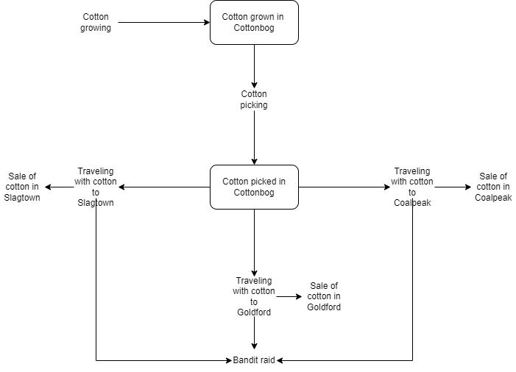
Flowchart (Cotton)

Slide 7
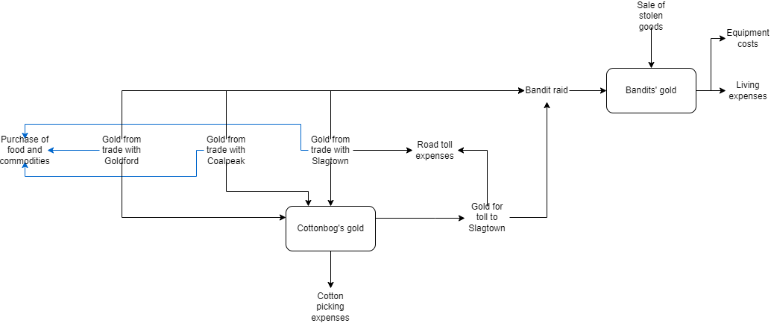
Flowchart (Gold)

Slide 8
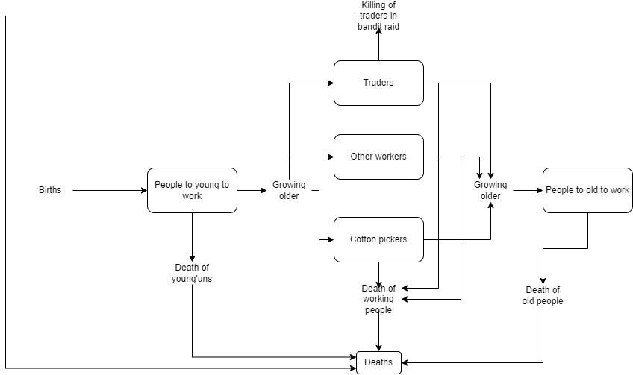
Flowchart (People)

Slide 9
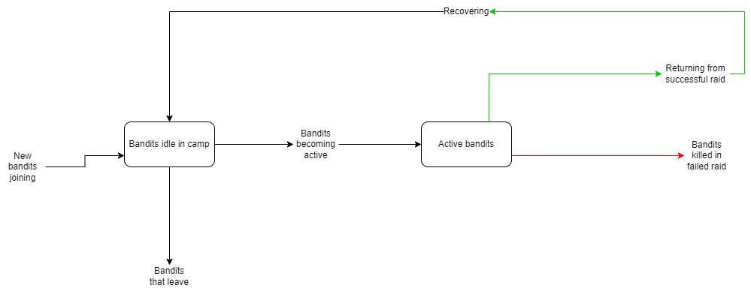
Flowchart (Bandits)

Slide 10
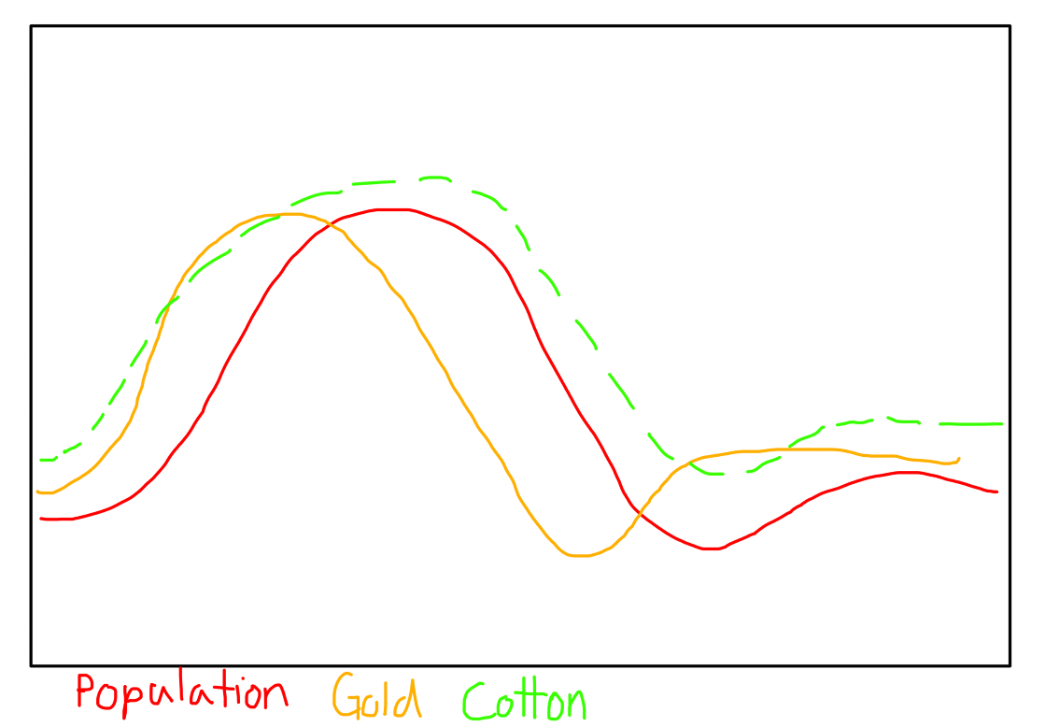
RBP for system

Slide 11
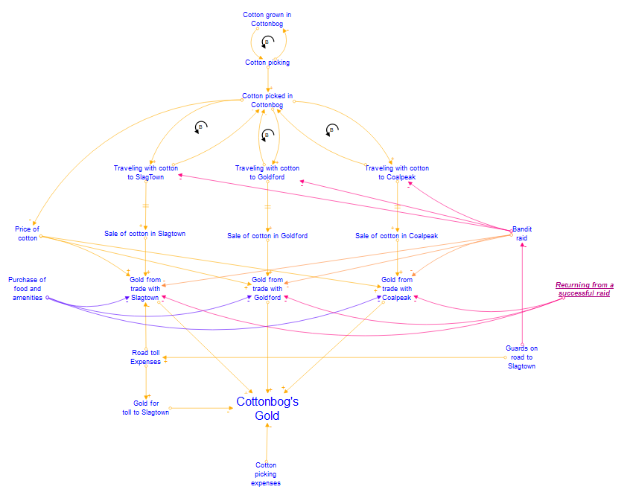
CLD Cotton/gold

Slide 12
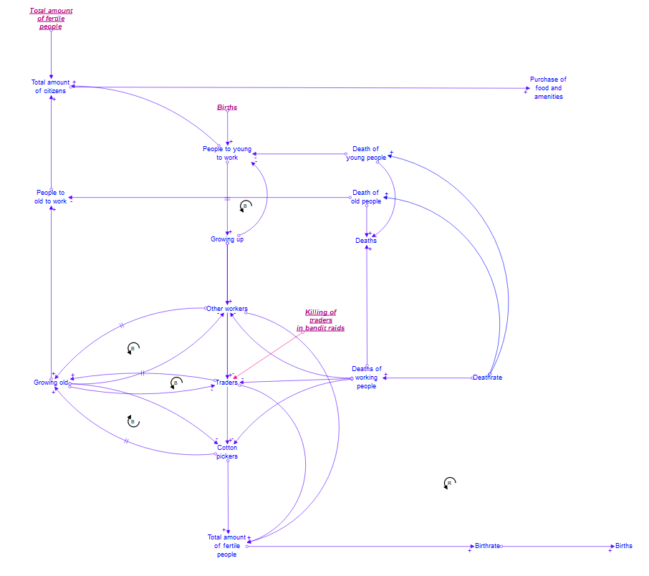
CLD Population

Slide 13
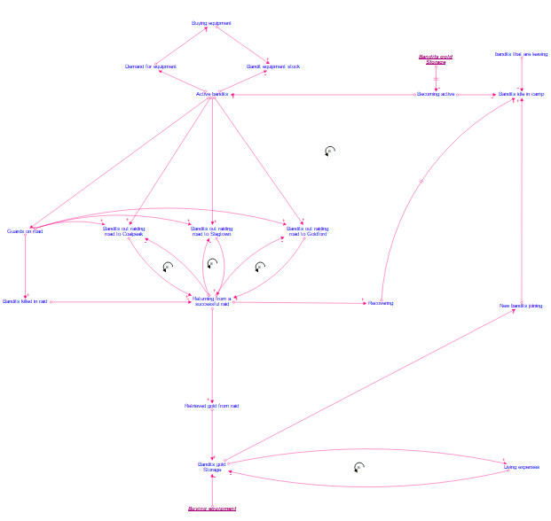
CLD Bandit camp

Slide 14
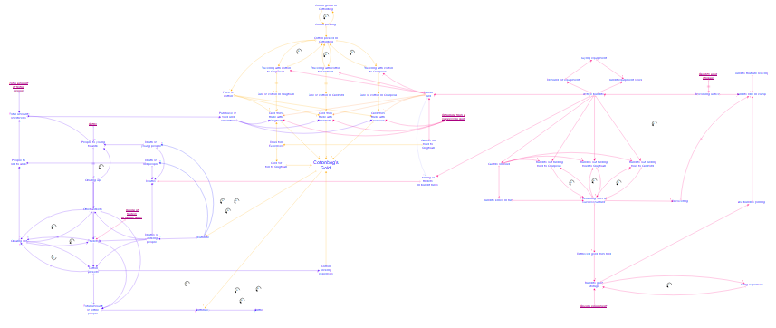
Combined CLD
Klikk for å legge til tekst

Slide 15
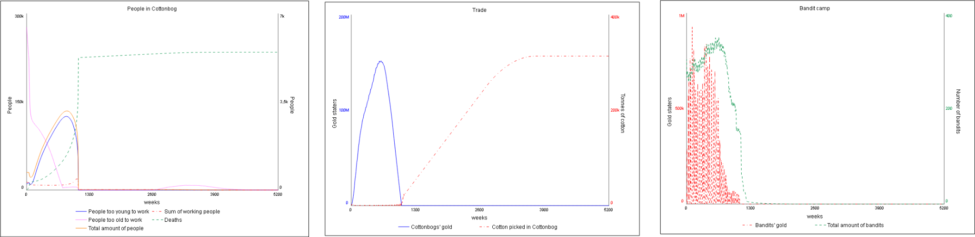
Stella model for Slagtown

Slide 16
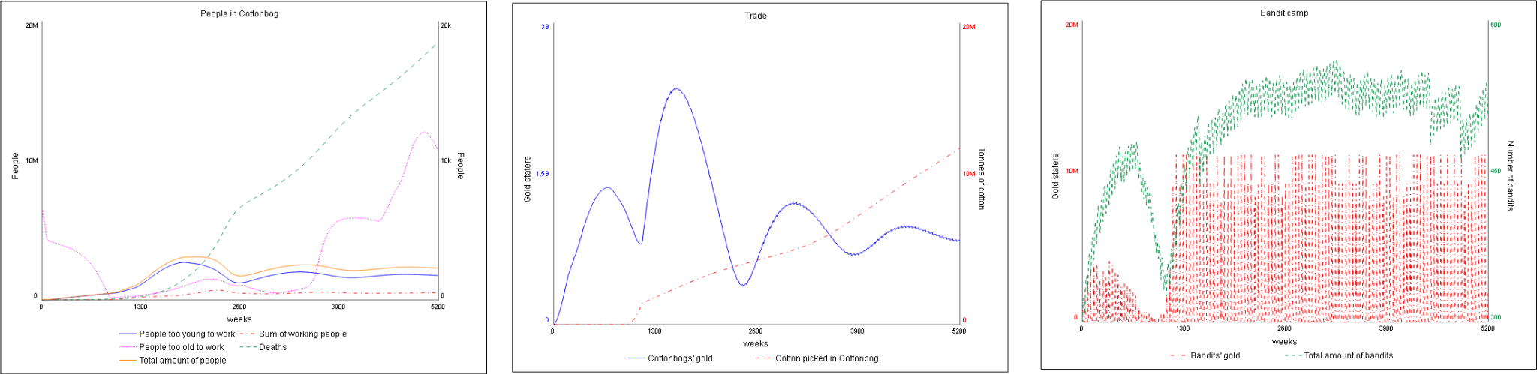
Stella model for Coalpeak

Slide 17
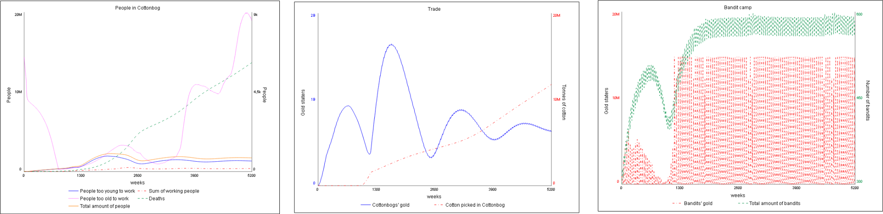
Stella model Goldford

Slide 18
Conclusion
Using system analysis and system dynamics, we were able to create a combined model for the production, trade and population in a fantasy city, and the banditry affecting its trade.
The qualitative model can be used as a guide for implementing numerical simulations of the systems in the final game.
The quantitative model can both be used to prototype various parameters and view their effect on the system, to fine-tune the final implementation in game, and as a blueprint for the in-game implementation of the model.

